Slide 1
Basic ICP and K8S

Slide 2
Agenda
Docker – recap
K8S or Kubernetes – what good does it do ?
ICP – so you say IBM has an actual platform for it ?
CI/CD – what the hell does it mean ?
CI/CD in your own environment
Your own example – development to deployment in practice
Jenkins - Some Jenkins examples for you Jenkins lovers
TFS – in depth

Slide 3
Docker - recap

Slide 4
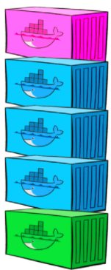
Docker Is:
Docker is a lightweight container management engine software.
help users easily achieve distributed applications
Build
Ship
Run

Slide 5
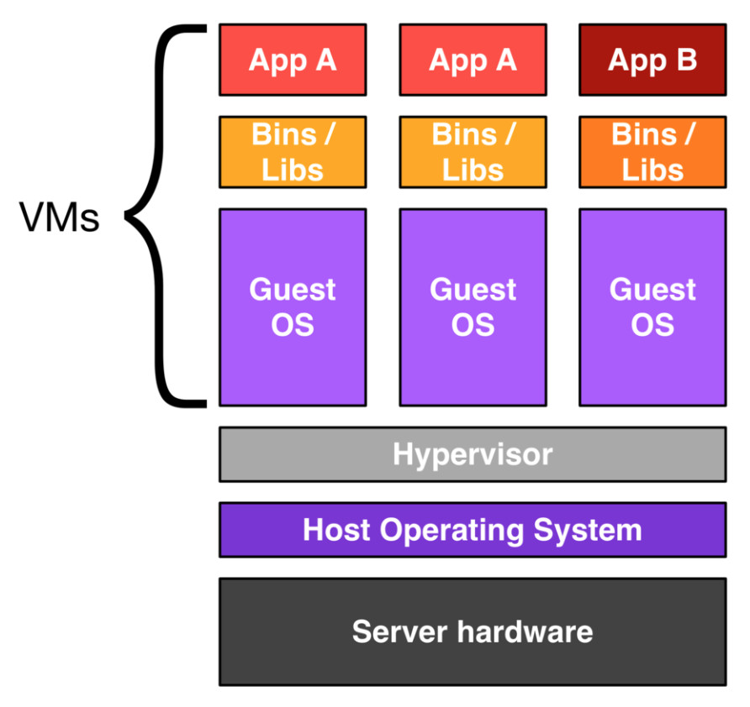
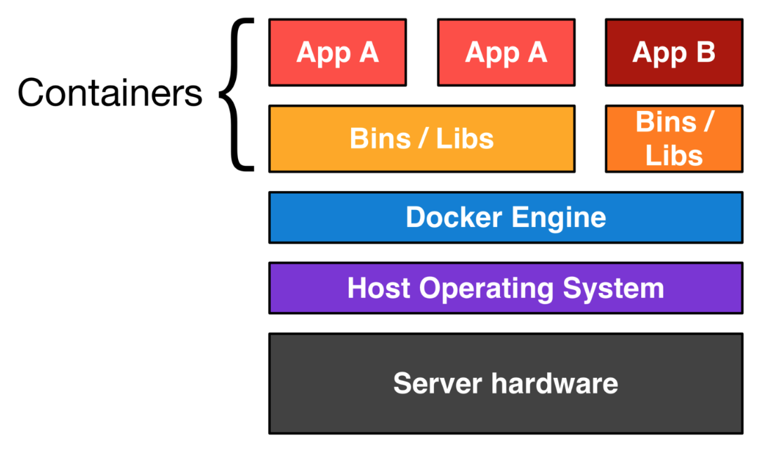
VM & Docker

Slide 6


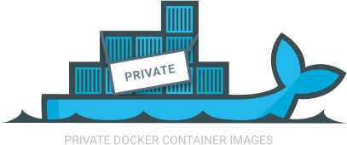
Docker components
Image
Template to use for creating containers. Snapshot of Read-Only stored in Docker Hub。
Container
Basic unit on which application service runs。
Docker Hub
Store, distribute and share images of containers.
Establish and use in SaaS or enterprise.
Docker Repository
Pulling an image from Docker Trusted Registry is the same as pulling an image from Docker Hub or any other registry. Since DTR is secure by default, you always need to authenticate before pulling images.。

Slide 7
Docker components
Docker Engine
A program for creating containers and running them.
Run on a physical server or virtual machine.
User can operate with command。

Slide 8
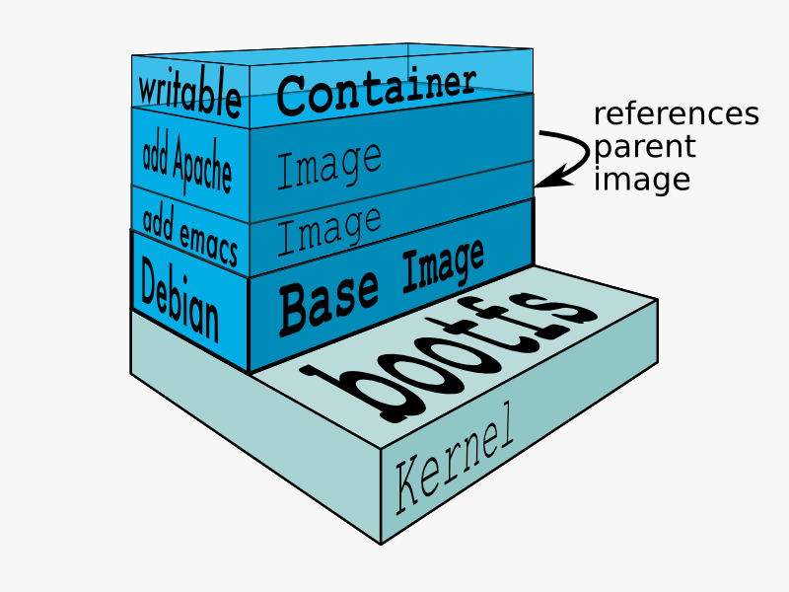
Layers of containers
Any RUN commands you specify in the Dockerfile creates a new layer for the container. In the end when you run your container, Docker combines these layers and runs your containers. Layering helps Docker to reduce duplication and increases the re-use.

Slide 9
The Docker Flow
Image
Image
Image
docker run
Running
Container
Running
Container
Running
Container
Volumes
Virtual “discs” to store and share data
Persistence (host)
Ephemeral (exist as long as the container use it)

Slide 10
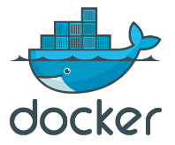



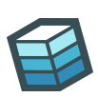
Docker provides a mechanism for managing Linux containers.
Docker Hub/Reg
Docker Engine
Image 1
Image 2
Image 3
Image 4
PULL
Image 4
Image 1
App A
App B
App C
App D
App A
App D
Image 4’
Bins/Libs
Bins/Libs
Bins/Libs
Bins/Libs
Bins/Libs
App D
Bins/Libs
user
Bins/Libs
RUN
RUN
Developers
docker search
docker pull
docker run
docker ps
docker start
docker stop
docker commit
docker rm
docker image
docker rmi
COMMIT
PUSH
docker build
docker push
docker tag
Con-1
Con-4
App A
App D
Docker
container
Docker command
Image 1
BUILD
App A
Bins/Libs
Bins/Libs
Bins/Libs
Physical server /
virtual machine
Docker file
image
Docker
command

Slide 11
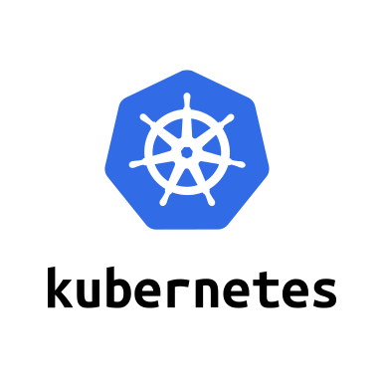
Introduction to Kubernetes

Slide 12
What is container orchestration?
Container orchestration
Manages the deployment, placement, and lifecycle of workload containers
Cluster management
Federates multiple hosts into one target
Scheduling
Distributes containers across nodes
Service discovery
Knows where the containers are located
Distributes client requests across the containers
Replication
Ensures the right number of nodes and containers
Health management
Replaces unhealthy containers and nodes
Container Orchestrator
Manager
Image Repository
Scheduler
Discovery DB
Replicator
Node
Node
Node
Daemon
Daemon
Daemon
Containers
Containers
Containers

Slide 13
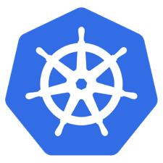
What is Kubernetes?
Container orchestrator
Runs and manages containers
Unified API for deploying web applications, batch jobs, and databases
Maintains and tracks the global view of the cluster
Supports multiple cloud and bare-metal environments
Manage applications, not machines
Rolling updates, canary deploys, and blue-green deployments
Designed for extensibility
Rich ecosystem of plug-ins for scheduling, storage, networking
Open source project managed by the Linux Foundation
Inspired and informed by Google's experiences and internal systems
100% open source, written in Go

Slide 14
Kubernetes Strengths
Kubernetes has a clear governance model
A growing and vibrant Kubernetes ecosystem
The commercial viability of Kubernetes makes it an interesting choice for vendors.
Despite the expected growth in commercial distributions, Kubernetes avoids dependency and vendor lock-in
Kubernetes supports a wide range of deployment options.
The design of Kubernetes is more operations-centric

Slide 15
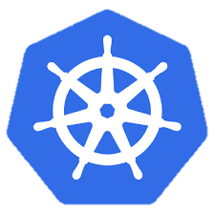
Kubernetes Cluster Architecture
internet
Master node
Node that manages the cluster
Scheduling, replication & control
Multiple nodes for HA
Worker nodes
Node where pods are run
Docker engine
kubelet agent accepts & executes commands from the master to manage pods
cAdvisor – Container Advisor provides resource usage and performance statistics
kube-proxy – routes inbound or ingress traffic
kubectl
firewall
Kubernetes cluster
Worker node
kube-proxy
kubelet
docker
pod
pod
pod
Master node
pod
pod
pod
cAdvisor
container
container
authentication authorization
container
container
APIs
container
scheduling
actuator
REST
Worker node
kube-proxy
controller manager
kubelet
Distributed watchable storage (etcd)
docker
pod
pod
pod
pod
pod
pod
cAdvisor
container
container
container
container
container

Slide 16
Kubernetes Architecture: How apps are accessed
Pod
Smallest deployment unit – runs containers
Each pod has its own IP
Shares a PID namespace, network, and hostname
Service
Collection of pods exposed as an endpoint
state and networking info propagated to all worker nodes
Types of service exposure
ClusterIP – Exposes cluster-internal IP
NodePort – Exposes the service on each Node’s IP at a static port
LoadBalancer – Exposes externally using a cloud provider’s load balancer
ExternalName – Maps to an external name (such as foo.bar.example.com)
Kubernetes components
Master Node
Worker Node 1
Pod
Pod
App A
App B
App A Client
App A Service
Worker Node 2
Pod
Pod
App B
App A
App B Client
App B Service
Worker Node 3
Pod
Pod
App A
App B

Slide 17
Configuring Resources and Containers
Label
Metadata assigned to Kubernetes resources (pods, services, etc.)
Key-value pairs for identification
Critical to Kubernetes as it relies on querying the cluster for resources that have certain labels
Selector
An expression that matches labels to identify related resources
ConfigMap
Configuration values to be used by containers in a pod
Stores configuration outside of the container image, making containers more reusable
Secret
Sensitive info that containers need to read or consume
Encrypted in special volumes mounted automatically

Slide 18
Kubernetes Management Architecture
UI
Master Node
Worker Node 1
Worker Node 2
API
Worker Node 3
CLI
Worker Node n
Registry
Etcd
API Server
Controller Manager Server
Scheduler

Slide 19
Kubectl Commands
Get the state of your cluster
$ kubectl cluster-info
Get all the nodes of your cluster
$ kubectl get nodes -o wide
Get info about the pods of your cluster
$ kubectl get pods -o wide
Get info about the replication controllers of your cluster
$ kubectl get rc -o wide
Get info about the services of your cluster
$ kubectl get services
Get full config info about a Service
$ kubectl get service NAME_OF_SERVICE -o json
Get the IP of a Pod
$ kubectl get pod NAME_OF_POD -template={{.status.podIP}}
Delete a Pod
$ kubectl delete pod NAME
Delete a Service
$ kubectl delete service NAME_OF_SERVICE

Slide 20
Resources
Kubernetes tutorial
https://kubernetes.io/docs/tutorials/kubernetes-basics/
Introduction to container orchestration
https://www.exoscale.ch/syslog/2016/07/26/container-orch/
TNS Research: The Present State of Container Orchestration
https://thenewstack.io/tns-research-present-state-container-orchestration/
Large-scale cluster management at Google with Borg
https://research.google.com/pubs/pub43438.html

Slide 21
ICp

Slide 22
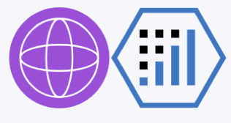

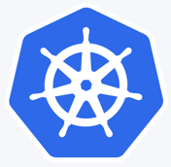
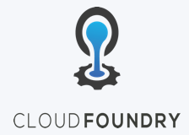
IBM Cloud Private – what is it ?
IBM Middleware, Data, Analytics and Developer Services
Cloud enabled middleware, messaging, databases, analytics, and cognitive services to optimize current investments while rapidly innovating
Enterprise grade services for Middleware, Data, Analytics, DevOps
Core Operational Services Simplify Operations Management, Security, and Hybrid integration Provision infrastructure and apps across Multi-Cloud environments
Enterprise grade operations, across your Hybrid IT environment
Kubernetes-based Container Platform
Industry leading container orchestration platform across private, dedicated & public clouds
Cloud Foundry
For prescribed app development & deployment
Open by design, preventing vendor lock-in
Leverage existing investments
Runs on existing IaaS:
System Z
IBM Spectrum
CMS
Third Party alliances:
Dell Cisco NetApp Lenovo Canonical …

Slide 23
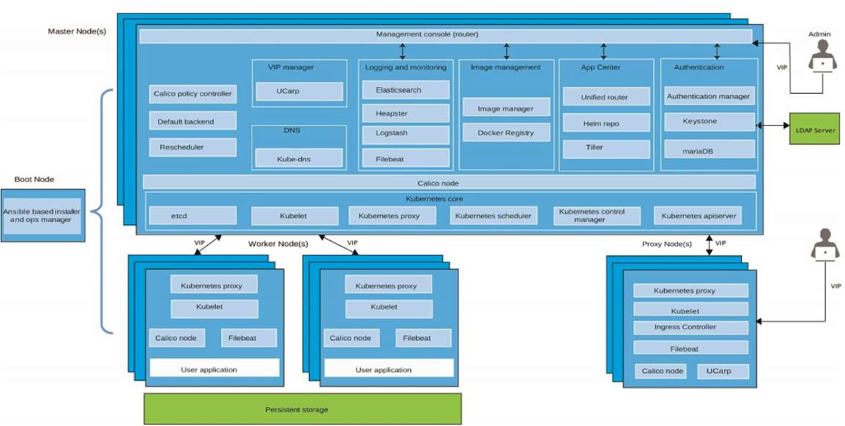
IBM Cloud Private – architecture components
Notes:
Go out and define each one of these components and maybe animate the whole thing
Need the slide source or completely rebuild slide with 2.1 changes

Slide 24
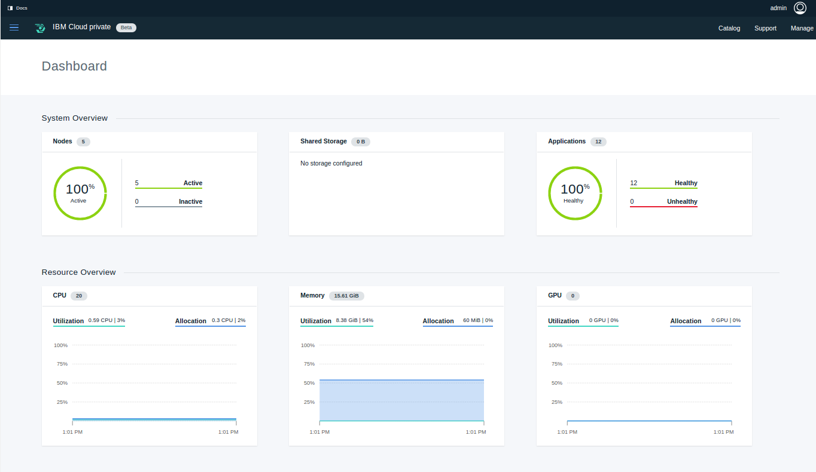
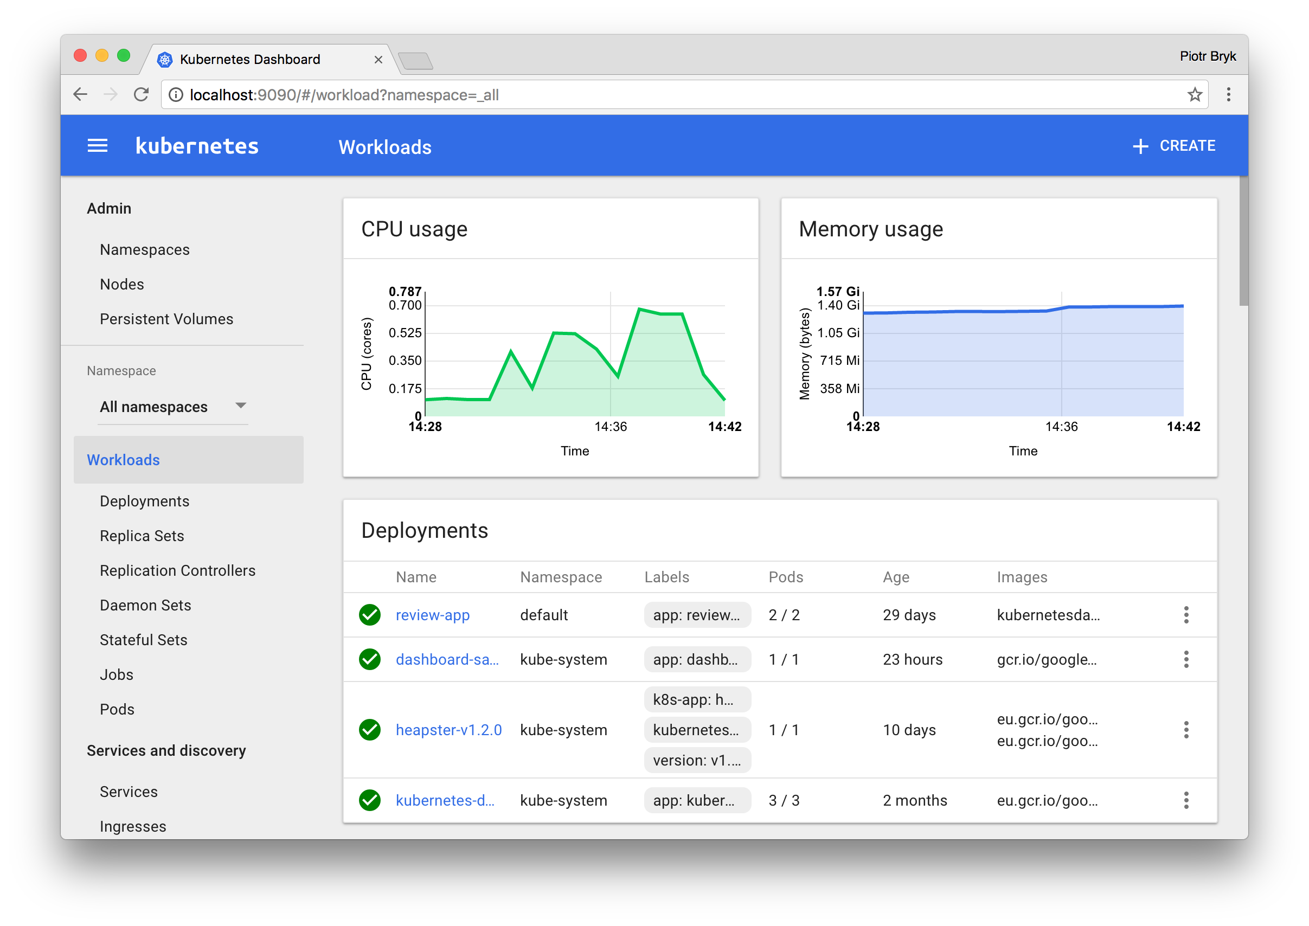
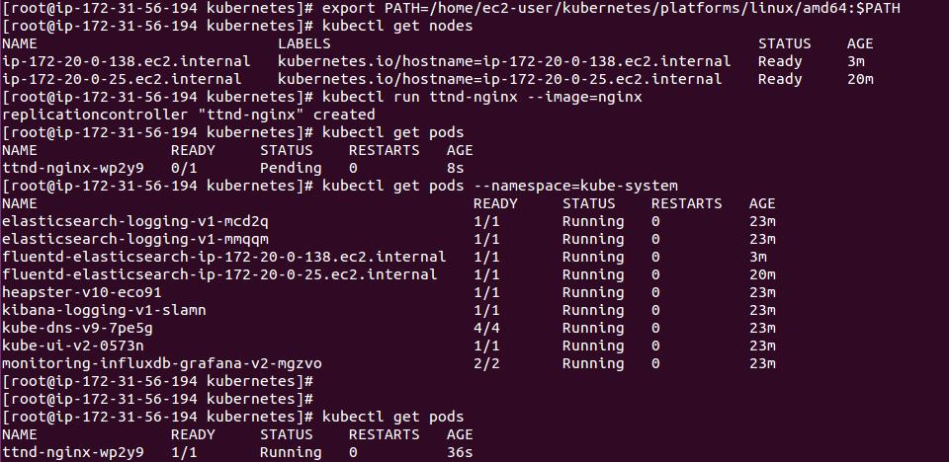
User Interfaces
Cluster Management Console: (ICP component) Use to manage, monitor, and troubleshoot your applications and cluster from a single, centralized, and secure management console.
K8s Web UI: Can use to deploy containerized applications to a Kubernetes cluster, troubleshoot your containerized application, and manage the cluster itself along with its attendant resources.
kubectl: A command-line interface for running commands against Kubernetes clusters.

Slide 25
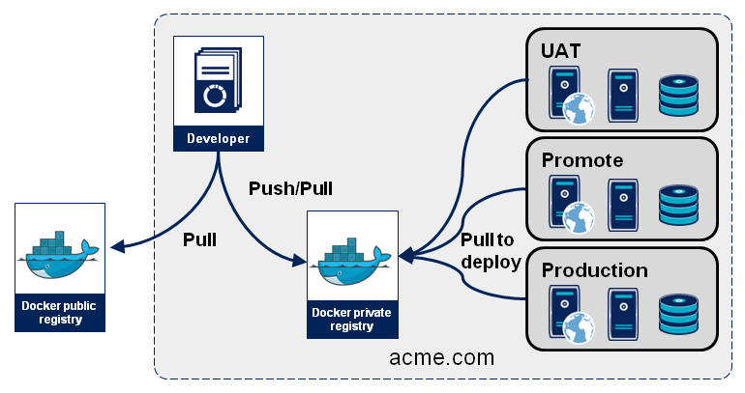
Images and Registries
You create a Docker image and push it to a registry before referring to it in a Kubernetes pod
There will likely be many registries used in your deployment
Notes:
Rework this with public and private registries

Slide 26
Storage in ICp

Slide 27
Persistent storage components (1 of 2)
Traditionally Containers: stateless, ephemeral in nature
Storage exists within the container
The container goes away and so goes the storage
Some applications desire state and thus persistent storage:
Specific aspects of configuration
Database (structured and unstructured)
Application data (website definitions, etc.)
Storage must be universally accessible across the K8s environment

Slide 28
Persistent storage components (2 of 2)
ICP Persistent Storage Support: HostPath, NFS, GlusterFS, vSphereVolume
Note: Reclaim policy and access modes and behaviors can vary
Access Modes:
ReadWriteOnce – the volume can be mounted as read-write by a single node
ReadOnlyMany – the volume can be mounted read-only by many nodes
ReadWriteMany – the volume can be mounted as read-write by many nodes
Notes:
Other popular providers not in support
CephFS
Google (GCE PersistentDisk)
AWS (ElasticBlockStore)
Azure (Azurefile, AzureDisk)
Cinder
FC
FlexVolume
Flocker
iSCSI
Quobyte
VspherVolume
Etc.

Slide 29
Volumes, persistent and temporary
A container file system only lives as long as the container does. When a container terminates, any data stored within the container is lost.
You must create a volume if the container needs persistent storage
Various types of data can be mounted as volume (e.g. Configmaps, Secrets, HostPath, ServiceAccount, etc.)
You can create several types of persistent storage
apiVersion: v1
kind: Pod
metadata:
name: redis
spec:
containers:
- name: redis
image: redis
volumeMounts:
- name: redis-persistent-storage
mountPath: /data/redis
volumes:
- name: redis-persistent-storage
emptyDir: {}

Slide 30
CI/CD - what the hell does it mean ?

Slide 31
Definitions
CI is Continuous Integration (Build/Ship)
Builds, unit tests, integration tests, performance tests, …
CD is Continuous Deployment (Run)
Deploying and maintaining pre production and production environment
CI is Dev, CD is Ops, so CI&D is DevOps (Build/Ship/Run)

Slide 32
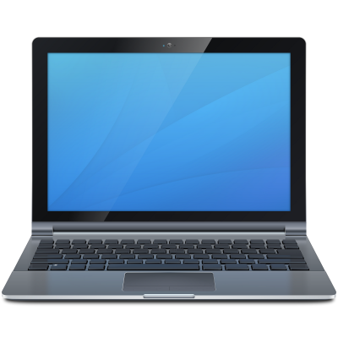
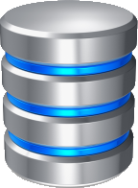
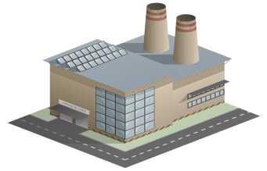


ICP Continuous Integration (Build/Ship/Run)
Frequently performing all of these steps in sequence:
Development
Rapidly implementing changes in small, tested batches
Source Code Management
Merging changes from multiple developers
Build
Creating new deployment artifacts
Package
Installing builds into runtimes
Releasing runtimes as immutable images
Development
SCM
Build
Package Repo
Continuous Integration
Squad/Team Level Automation
ICP

Slide 33





ICP Continuous Deployment (Build/Ship/Run)
Release Train
Rapidly progressing the latest packaged build through the test lifecycle stages and into production
Deploy to Test
Perform functional testing
Deploy to Stage
Rehearse production deployment
Perform integration testing
Deploy to Prod
Make the build available to users
Configure:
Applications
Middleware
Databases
APIs
Package Repo
Deploy
Test
Stage
Prod
Rules for promotion
Release
Automated Test Deployments

Slide 34
ICP CI/CD (Continuous Delivery) pipeline
Release Train
Configure:
Applications
Middleware
Databases
APIs
Development
SCM
Build
Package Repo
Deploy
Test
Stage
Prod
Continuous Integration
Rules for promotion
Squad/Team Level Automation
Release
Development/Test/Production parity
Automated Test Deployments

Slide 35
CI/CD in your own environment

Slide 36
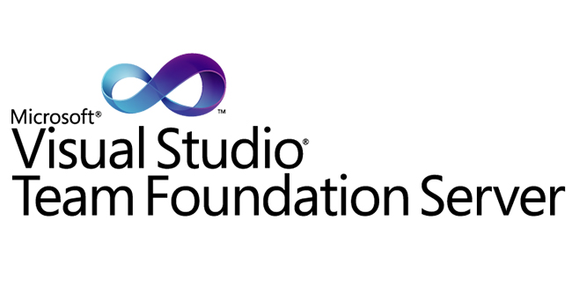
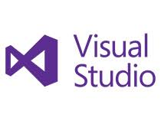

ICP CI/CD (Continuous Delivery) pipeline
Development
SCM
Build
Package Repo
Deploy
Test
Stage
Prod
Continuous Integration
Rules for promotion
Release
Development/Test/Production parity
Automated Test Deployments

Slide 37
Let’s see it in action

Slide 38
And the Jenkins equivalent

Slide 39
Jenkins build and push
export DOCKER_TLS_VERIFY=1
export DOCKER_CERT_PATH=/var/lib/jenkins/ucp-cas
#variable declaration
ICP_REGISTRY=master.cfc:8500
ICP_NAMESPACE=labassaf
ICP_USER=assaf
ICP_PASSWORD=assaf
#login to ICP
docker login -u=${ICP_USER} -p=${ICP_PASSWORD} ${ICP_REGISTRY}
#prepare the container image for the DB
cd ${WORKSPACE}/jke.app/docker.jke.db
docker build -t jke/jke.db:${BUILD_NUMBER} .
docker tag jke/jke.db:${BUILD_NUMBER} ${ICP_REGISTRY}/${ICP_NAMESPACE}/jke/jke.db:${BUILD_NUMBER}
#push to ICP
docker push ${ICP_REGISTRY}/${ICP_NAMESPACE}/jke/jke.db:${BUILD_NUMBER}

Slide 40
Jenkins deploy
Using the *.yaml files you created, a kubectl command is issued.
Example
kubectl apply –f blabla.yaml

Slide 41
TFS – deep dive

